Slide 1

Comprehensive Comparative Insights between a Base Neural Network Model and a CNN Model
Group 3
Vikas Reddy Gillella
Venkatesh Mamidipalli
Abhishek Ram Karuturi
Notes:
Save this document with a new name before you begin work.
When adding a new slide, click on the small arrow next to “New Slide” on the toolbar. Select the layout that will best fit the content you want to add.
Change the layout of an existing slide: click the “Layout” button on the top toolbar to reformat your existing content to another master slide.
Refer to utdallas.edu/brand for specific rules on using the University logos and wordmarks.

Slide 2
Problem Statement
The project aims to explore and compare neural network architectures for clothing classification using the Fashion-MNIST dataset. The primary objectives include developing a baseline neural network model (NN) as a reference point and constructing a deep convolutional neural network (CNN) specifically tailored for image classification.
By quantitatively comparing the performance of these models in terms of accuracy, training time, and robustness, we seek to enhance our understanding of neural network architectures and inform future model selection and improvements in the field of computer vision and deep learning.

Slide 3
Data Set
Fashion-MNIST is a dataset of Zalando's article images—consisting of a training set of 60,000 examples and a test set of 10,000 examples. Each example is a 28x28 grayscale image, associated with a label from 10 classes. Zalando intends Fashion-MNIST to serve as a direct drop-in replacement for the original MNIST dataset for benchmarking machine learning algorithms. It shares the same image size and structure of training and testing splits.
The Fashion MNIST dataset represents a more challenging variant of the classic MNIST dataset and is a common task for e-commerce platforms, fashion recommendation systems, inventory management and other real-world scenarios.
Fashion MNIST serves as a benchmark for evaluating machine learning and deep learning models.
Each image in the data set is 28 pixels in height and 28 pixels in width, for a total of 784 pixels in total.
Each pixel has a single pixel-value associated with it, indicating the lightness or darkness of that pixel, with higher numbers meaning darker. This pixel-value is an integer between 0 and 255.

Slide 4
Data Set
Labels
Each training and test example is assigned to one of the following labels:
0 T-shirt/top
1 Trouser
2 Pullover
3 Dress
4 Coat
5 Sandal
6 Shirt
7 Sneaker
8 Bag
9 Ankle boot
Each row is a separate image
Column 1 is the class label.
Remaining columns are pixel numbers (784 total).
Each value is the darkness of the pixel (1 to 255)

Slide 5
Importance of the Problem
1.Understanding the importance of Convolutional Neural Networks (CNNs):
Fashion-MNIST dataset serves as an excellent starting point for transitioning from basic neural networks to more sophisticated architectures like CNNs.
CNNs excel at handling spatial hierarchies and local patterns. They automatically learn relevant features from raw pixel data, making them well-suited for image classification tasks.
By comparing the performance of a base neural network with that of a CNN on Fashion MNIST, we can observe the advantages of using specialized architectures for visual data
2.Benchmarking and Comparison:
By comparing your base neural network (NN) model with a convolutional neural network (CNN), you can assess their performance on this dataset.
Understanding the differences in accuracy, training time, and complexity between these models provides valuable insights.

Slide 6
3.Generalization and Transfer Learning:
Techniques learned from this dataset can be applied to more complex image classification tasks.
Generalizing from Fashion MNIST to other domains demonstrates the versatility of our models.
4.Educational Value:
It allows us to develop, evaluate, and use deep CNNs for image classification from scratch.
As a standard dataset, it provides a solid foundation for understanding neural networks and their applications.
Exploring Model Complexity:
1. Researchers can experiment with different neural network architectures, layer depths, and activation functions using Fashion MNIST.
2. Comparing the performance of shallow networks, deep networks, and CNNs sheds light on the impact of model complexity on accuracy and convergence.

Slide 7
Approach
The goal of our project is to explore and compare the performance of two different neural network architectures on the Fashion-MNIST dataset.
Base Neural Network (NN) Model: Develop a baseline neural network model for clothing classification using the Fashion-MNIST dataset. This model will serve as our reference point for evaluating the effectiveness of more complex architectures.
Convolutional Neural Network (CNN) Model: Construct a deep convolutional neural network tailored for image classification. The CNN should leverage spatial hierarchies and feature extraction capabilities to improve accuracy compared to the base NN model.
Comparison and Analysis: Quantitatively compare the performance of the base NN model and the CNN model in terms of accuracy, training time, and robustness. Additionally, explore any insights gained from the comparison to inform future model selection and improvements.

Slide 8

Importing Dataset and defining class_names

Slide 9
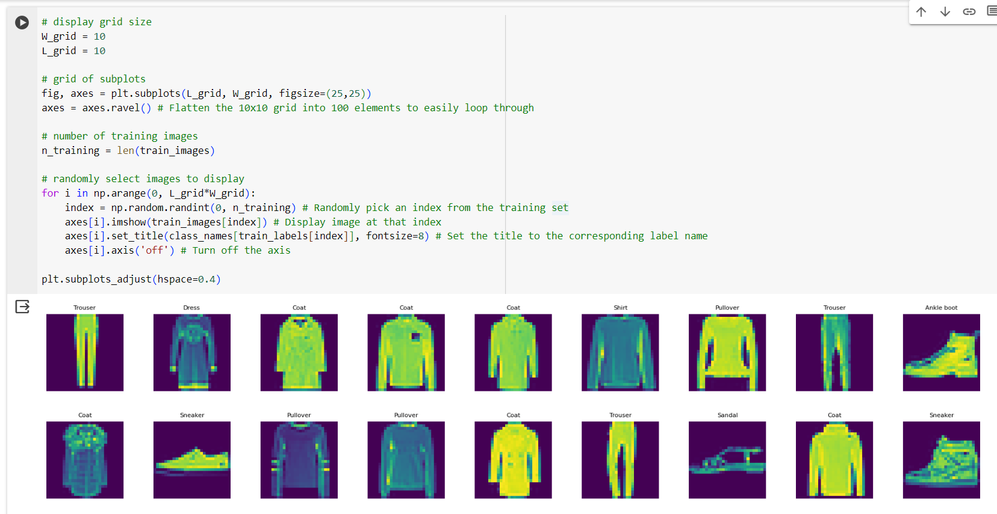
Display Sample images from train data with intensity of pixels

Slide 10
Normalizing the image pixel values from [0, 255] to [0, 1]
We'll normalize the pixel values to be 0 to 1 by dividing by 255 (since pixel values range from 0 to 255).
Why Normalize:
Improves Numerical Stability: Normalization ensures consistent input values, reducing the risk of gradient explosion or underflow during training.
Enhances Model Generalization: Normalized inputs help prevent the model from focusing too much on specific features, improving its ability to generalize to new and unseen data. Facilitates
Model Consistency: Consistent data ranges across layers ensure stable and uniform computations, aiding the overall training process. Compatibility with
Activation Functions: Normalized inputs enable activation functions like sigmoid and tanh to perform effectively in their expected range, aiding in better non-linear learning.

Slide 11
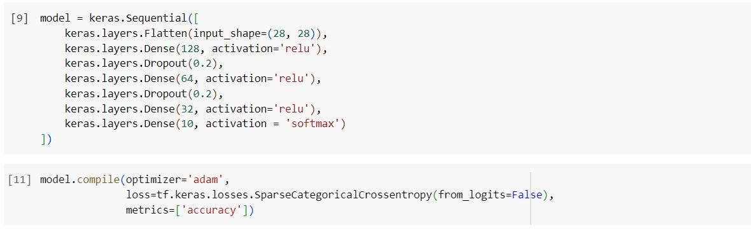
Training the Base NN model
Layers

Slide 12
Training the Base NN model
Flatten Layer: Converts the 2D input image data into a 1D array, making it compatible for subsequent dense layers.
Dense Layers: Dense layers with ReLU activations are effective at learning complex representations and abstractions from the input data. The dense layers provide flexibility in learning different patterns and features from the input data. Multiple dense layers are stacked to increase the complexity of the model and enable it to learn hierarchical features.
Dropout Layers: Dropout layers randomly drop units during training, helping to prevent overfitting and improve generalization. Dropout forces the model to learn more robust features by not relying too heavily on any specific subset of neurons.
Output Layer: Converts the output of the previous dense layer into a probability distribution across the 10 classes, suitable for multi-class classification. Provides interpretable probabilities for each class, allowing you to see the confidence of the model in its predictions.

Slide 13
Training the Base NN model
Optimizer:
optimizer='adam': Adam is an adaptive learning rate optimizer that combines the advantages of both the RMSProp and Adagrad optimizers. It is known for its robustness and efficiency, adjusting the learning rate based on past gradients.
Loss Function:
Categorical Cross-Entropy:Used when the target labels are one-hot encoded (e.g., [0, 1, 0, 0] for class 2). Measures the distance between the predicted probabilities and the one-hot encoded true labels.
Sparse Categorical Cross-Entropy:Used when the target labels are integer-encoded (e.g., 2 for class 2).Computes the cross-entropy loss in a similar manner to categorical cross-entropy but handles the integer labels directly without needing one-hot encoding.
from_logits=False: To inform the loss function that the model's output is a probability distribution and not raw logits.
Metrics:
metrics=['accuracy']: Accuracy is a straightforward metric that measures the proportion of correctly predicted labels. It is a good general measure of model performance, particularly for classification tasks.

Slide 14
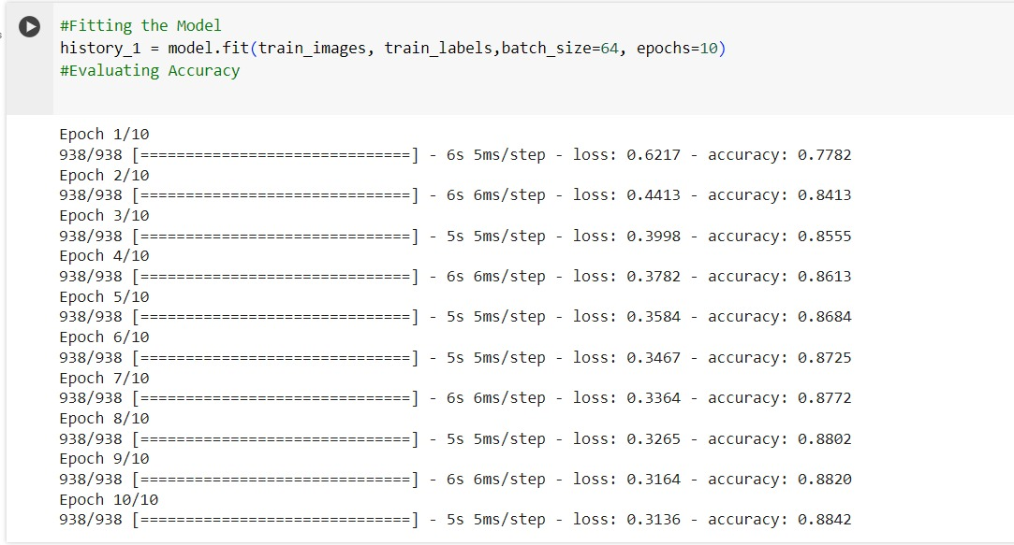
Fitting the Base NN model

Slide 15
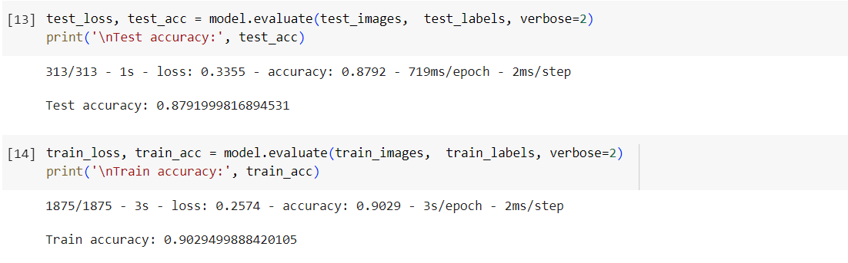
Test and Train Accuracy

Slide 16
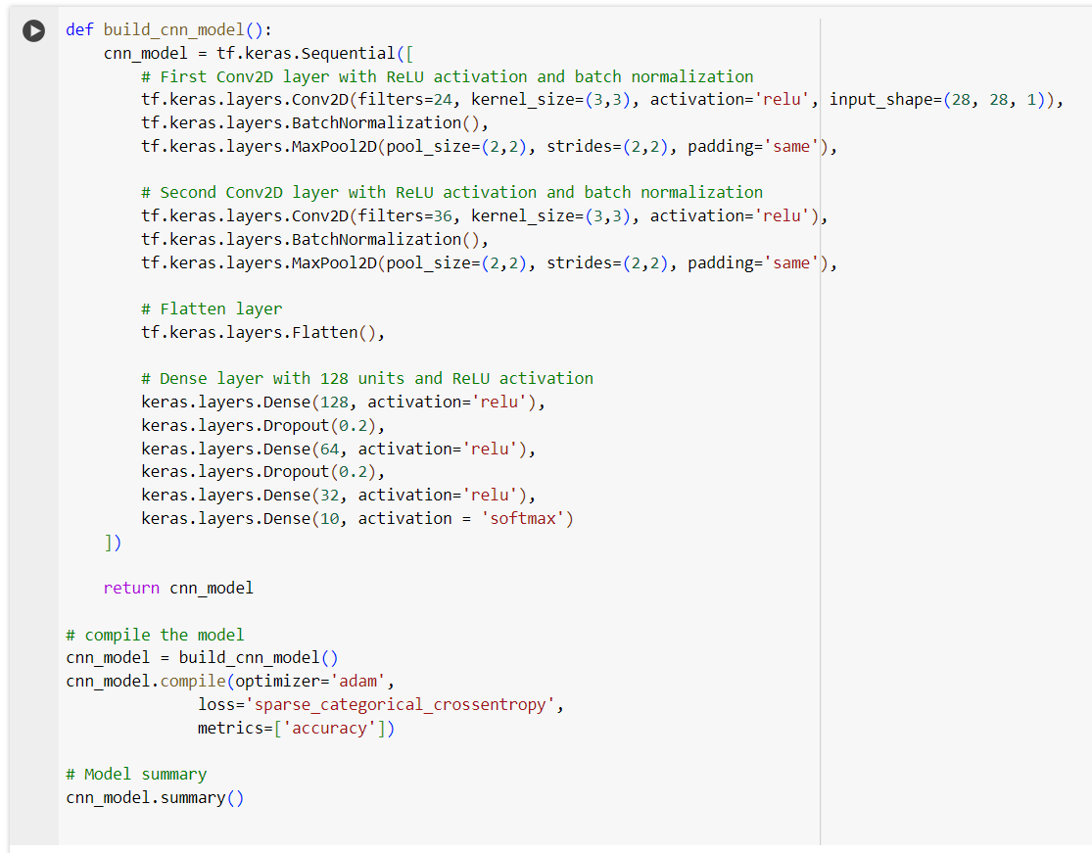
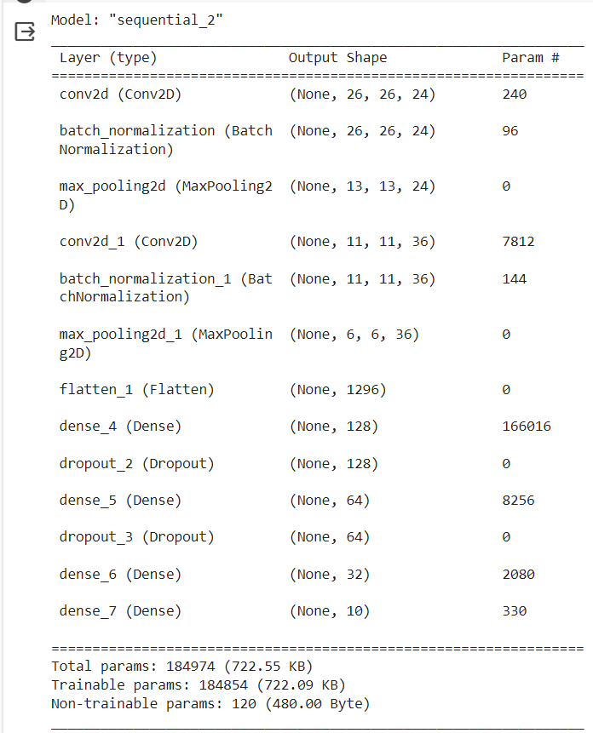
Train the CNN Model

Slide 17
Train the CNN Model
Conv2D Layers: Used 24 filters in the first Conv2D layer to learn various patterns and features from the input image. 3x3 kernel specifies the height and width of the filters, which determines the region of the input the filters will convolve over. ReLU (Rectified Linear Unit) activation function to introduce non-linearity, enabling the model to learn complex patterns. The layer accepts input data with the shape (28, 28, 1) for grayscale images. Second Conv2D Layer is similar to the first Conv2D layer but uses 36 filters, allowing the model to learn more complex patterns from the input data.
Batch Normalization: Normalizes the activations from the Conv2D layers to stabilize training and improve convergence. Adjusts and scales activations within each layer, allowing the network to operate on a more standardized input.
MaxPool2D Layers: Pool size determines the size of the region of the feature map that the MaxPool2D layer processes at once.A pool size of (2,2) means that each 2x2 region of the input feature map is downsampled by taking the maximum value in that region.
Strides control how much the filter moves across the input data.Larger strides (e.g., 2,2) help reduce the size of the feature map quickly, which can be beneficial for computational efficiency.

Slide 18
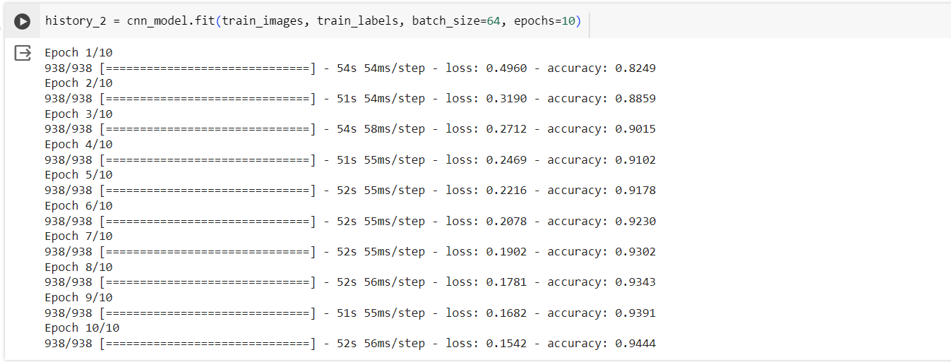
Fit the CNN model

Slide 19
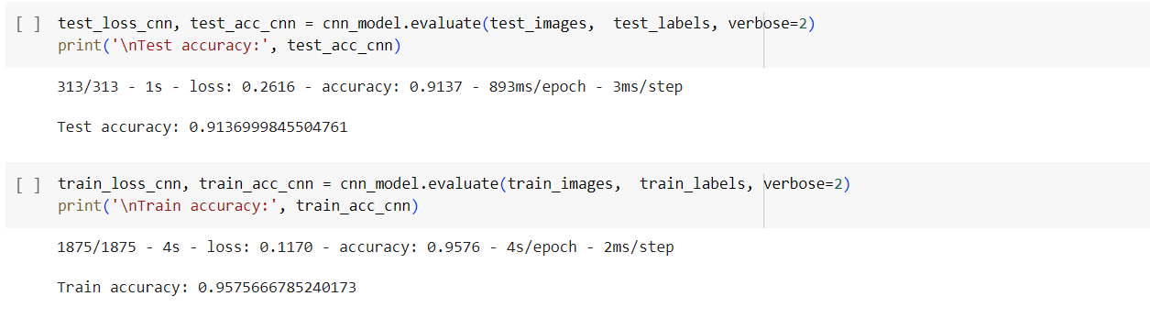
Test and Train accuracy of the CNN model

Slide 20
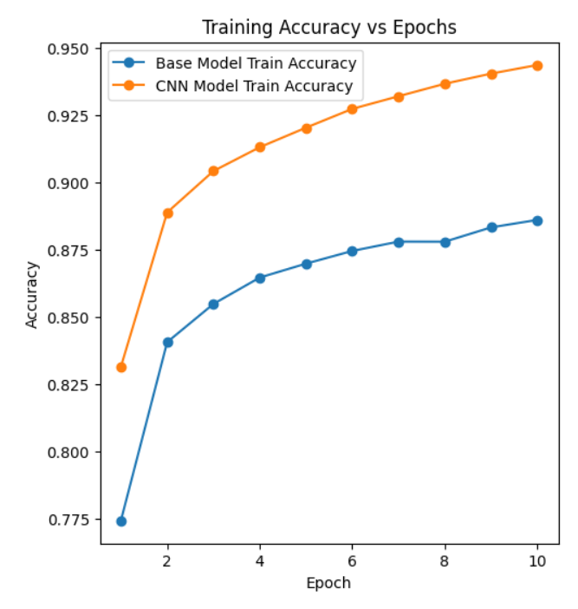
Comparing Accuracy of the Base and CNN Models
Base Model Train Accuracy (Blue Line):
As training progresses, the base model gradually improves its accuracy.
However, the rate of improvement is relatively moderate.
CNN Model Train Accuracy (Orange Line):
Throughout the training process, the CNN model consistently exhibits rapid improvement.
The steep upward trend indicates that the CNN model adapts well to the data.
In summary, the CNN model significantly outperforms the base model in terms of training accuracy. Its faster convergence and higher final accuracy make it the preferred choice for this task.

Slide 21
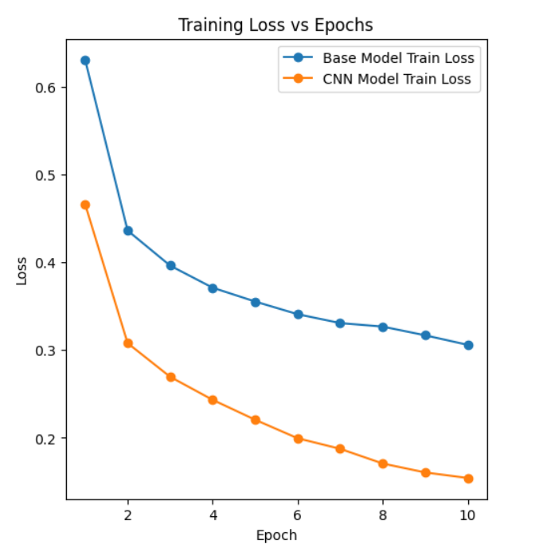
Comparing Loss of the Base and CNN Models
Base Model Training Loss (Blue Line):
As training progresses, the base model consistently reduces its loss.
The base model exhibits a sharp decline in loss initially and then gradually converges.
CNN Model Training Loss (Orange Line):
Throughout the training process, the CNN model steadily decreases its loss.
Unlike the base model, the CNN model maintains a more consistent decline in loss over epochs.
In summary, both models reduce their losses over time, but they exhibit different patterns of decline. The base model converges faster initially, while the CNN model maintains a steadier decrease. The choice between the two models depends on specific trade-offs and performance requirements for your task.

Slide 22
Comparative Insights
Learning Curve:
Base Neural Network Model: Exhibits a smoother learning curve with a steady decrease in loss and increase in accuracy over epochs.
CNN Model: Shows a faster and more significant improvement in loss and accuracy, demonstrating its efficiency in learning from data.
Convergence Speed:
Base Neural Network Model: Takes longer to converge to a reasonable loss and accuracy level compared to the CNN model.
CNN Model: Converges more quickly and reaches a lower final loss, indicating better learning efficiency.

Slide 23
Final Accuracy:
Base Neural Network Model: Achieves a final test accuracy of 0.8827, which is decent but lower than the CNN model.
CNN Model: Reaches a higher final test accuracy of 0.9137, demonstrating its superior ability to generalize to new data.Model Architecture:
Complexity:
Base Neural Network Model: Uses a simpler architecture primarily consisting of dense layers with ReLU and softmax activations.
CNN Model: Employs a more complex architecture with convolutional layers, max pooling, and batch normalization, allowing for better feature extraction and learning.
Feature Learning:
Base Neural Network Model: Relies primarily on dense layers, which may not capture spatial features in the data as effectively.
CNN Model: Convolutional layers enable better learning of spatial features and hierarchical representations, contributing to improved performance.

Slide 24
Regularization:
Base Neural Network Model: Lacks regularization techniques such as dropout, which may lead to overfitting.
CNN Model: Includes dropout layers and batch normalization, providing effective regularization and mitigating overfitting.
Resource Utilization and Scalability:
Base Neural Network Model:Uses fewer parameters and may require less computational resources, but at the cost of lower performance.Easier to train on smaller datasets due to its simpler architecture.
CNN Model:Utilizes more parameters and computational resources but offers higher performance and scalability.Can handle larger datasets and more complex tasks effectively.
Model Robustness:
Base Neural Network Model:More prone to model degradation with noisy or unfamiliar data due to simpler architecture.May require additional fine-tuning to handle varying data distributions.
CNN Model:More robust against noise and data variations due to its ability to learn spatial hierarchies and features.Better equipped to handle complex datasets and new data distributions.

Slide 25

THANK YOU
Thank you

